Slide 1


Network & System Administration
Network Infrastructure

Slide 2
Agenda
Week | 5th Week
Day
Duration | 4hrs
TIME | TOPIC & ACTIVITY | CPMPLETED-
30 Mins | Network Devices (routers, switches, firewalls) | Yes/No
60 Mins | VLANs and Trucking | Yes/No
15 Mins | Break | Yes/No
45 Mins | Virtual Private Networks (VPNs) | Yes/No
30 Mins | Q&A Session on lesson learnt | Yes/No
15 Mins | Break | Yes/No
60 Mins | Wireless Network Administration | Yes/No
15 Mins | Group Discussion | Yes/No

Slide 3
Learning Objectives
5.1 Network Devices (routers, switches, firewalls)
5.2 VLANs and Trucking
5.3 Virtual Private Networks (VPNs)
5.4 Wireless Network Administration

Slide 4
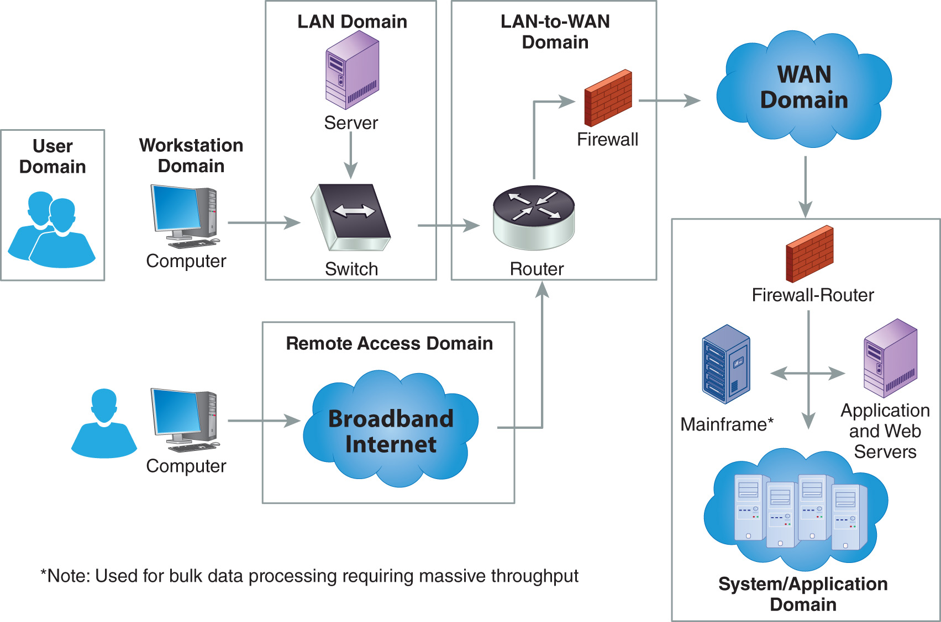
What is a network infrastructure?
Network infrastructure refers to the collection of hardware and software resources that enable network connectivity, communication, operations, and management. This infrastructure forms the backbone of an organization's IT environment, ensuring data can be transmitted efficiently and securely between devices, systems, and locations.

Slide 5
Components of a Network Infrastructure
Physical Components
Routers
Logical Components
Protocols
Switches
Firewalls
Servers
Cabling: Physical cables
Access Points
Modems
Data Centers
Software
IP Addresses
Network Topologies
DNS (Domain Name System)

Slide 6
5.1 Network devices (routers, switches, firewalls)

Slide 7
The Function of a Router
Function:
A device that links multiple packet-switched networks or subnetworks is referred to as a router. By forwarding data packets to their appropriate IP addresses, it manages traffic between these networks and lets numerous devices access an Internet connection.
Features:
Firewall: To protect networks from illegal access and cyberspace risks, a lot of contemporary routers come with built-in firewalls.
Quality of Service (QoS): QoS enables routers to give priority to specific types of network traffic, guaranteeing uninterrupted operation for vital applications such as online gaming and video conferencing.
Virtual Private Network (VPN): Users can connect to a network from outside by using routers equipped with VPN capabilities, which offer secure remote access.
Port forwarding: With the help of this capability, particular data packets can be routed to network devices.

Slide 8
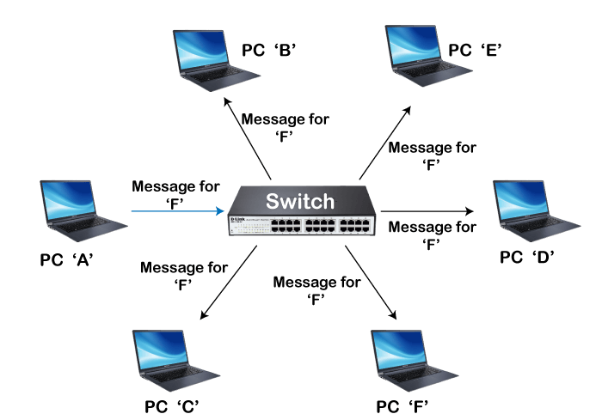
The Function of a Switch
Function:
Devices on a local area network (LAN) are connected to and receive data packets from a network, use MAC addresses to forward data.
Features:
VLAN Support: Segment a network into different logical networks.
Port Mirroring: Monitor network traffic for analysis and troubleshooting.
Quality of Service (QoS): Prioritize certain types of network traffic to ensure optimal performance.

Slide 9
The Function of a Firewall
Function:
Monitor and control incoming and outgoing network traffic.
Types:
Hardware: Physical devices that filter traffic between networks.
Software: Programs installed on individual computers or servers.
Hybrid: Combine both hardware and software components for enhanced security.
Features:
Packet Filtering: Inspect packets and allow or deny them based on predefined rules.
Proxy Service: Intercept and forward requests between clients and servers.
Stateful Inspection: Track the state of active connections and make decisions based on the context of traffic flows.

Slide 10
5.2 VLANs and trucking

Slide 11
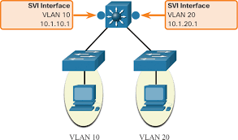
What is a VLAN?
A logical overlaying network known as a virtual LAN (VLAN) is used to isolate traffic for individual groups of devices that share a physical LAN.
A Local Area Network (LAN) is a collection of computers or other devices that are in the same area, such as the same building or campus, and share a common physical network. An Ethernet (Layer 2) broadcast domain, or the range of network devices that an Ethernet broadcast packet can reach, is typically linked to a local area network (LAN).

Slide 12
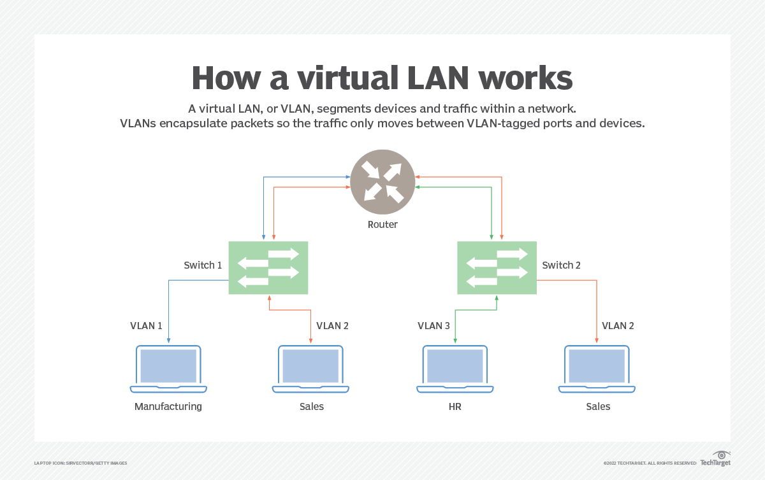
How a VLAN works

Slide 13
Configuring a VLAN
L2 Switch
Adding VLAN10
L2_Switch(config)#vlan 10-11
L2_Switch(config-vlan)#name IT.Dep
L2_Switch(config-vlan)#exit
Assigning to a Port.
L2_Switch(config)#interface gigabitEthernet 0/0
L2_Switch(config-if)#switchport mode access
L2_Switch(config-if)#switchport access vlan 11
L2_Switch(config-if)#exit
Save Configuration.
L2_Switch#write memory

Slide 14
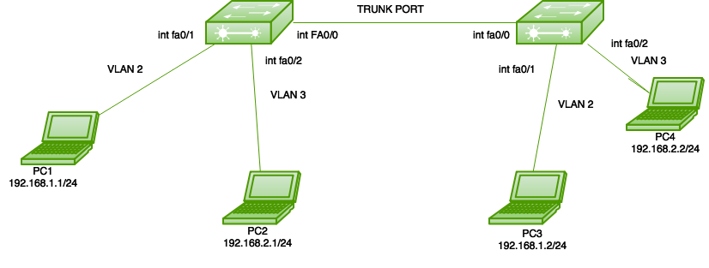
VLAN Trunking.
An important development was the transition from hubs, or shared networks, to switched networks. Infrastructure upgrades are strongly encouraged by the additional functionality that switches offer, higher throughput, and control over clashes. However, there are some challenges associated with Layer 2 switched topologies. Widely used flat topologies may result in overflowing broadcast domains and security, redundancy, and load balancing limitations. Virtual local area networks, or VLANs, are one way to reduce these problems. The IEEE 802.1Q-standard VLAN architecture and functionality .

Slide 15
5.3 Virtual Private Networks (VPNs)

Slide 16
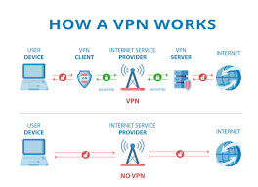
VPN (Virtual Private Network).
Definition of VPN:
Technology known as a virtual private network (VPN) establishes a secure, encrypted link over a less secure network, such the Internet. Using a public network like the Internet, a virtual private network can be used to expand a private network. All that the name implies is that it is a "Virtual Private Network," meaning that a user can join a local network from a distance. It creates a secure connection by using tuning protocols.

Slide 17
Benefits of a VPN (Virtual Private Network).
1. Secure Remote Access:
Virtual Private Networks (VPNs) allow users to safely access to a private network from a distance. This feature is particularly helpful for companies that have workers that work remotely. This guarantees that private information sent over the internet is protected from attackers and suspicious parties.
2. Cost-effective:
By utilizing a VPN, businesses can cut reduce the expenses related to setting up and keeping up private, physical networks. They can establish a private, secure communication channel using the current internet infrastructure in place of dedicated leased lines. Businesses with numerous remote offices or personnel that travel regularly will find this to be especially helpful.

Slide 18
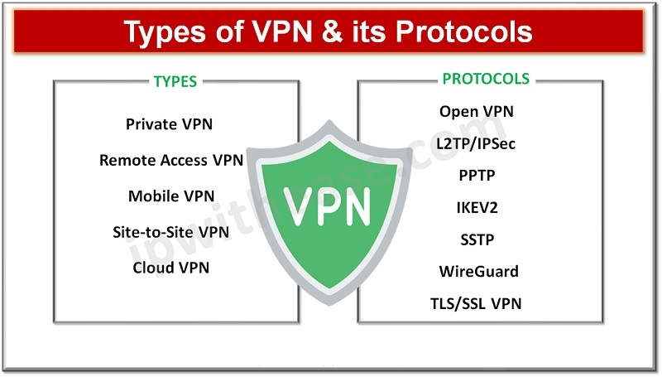
Types of VPN (Virtual Private Network).

Slide 19
Q&Q Session on Lesson learned

Slide 20
Q&Q Session
Q1: What is the primary function of a router in a network?
A1: A router's primary function is to direct data packets between different networks by determining the optimal path for data transmission.
Q2: How do switches differ from routers?
A2: Switches operate at the data link layer and are used to connect devices within the same network, using MAC addresses to forward data. Routers operate at the network layer and connect different networks, using IP addresses to route data.
Q3What is trunking and how does it support VLANs?
A3: Trunking is a method that allows multiple VLANs to share a single network link. It uses protocols like IEEE 802.1Q to tag VLAN traffic, ensuring data from different VLANs can traverse the same physical link while remaining logically separate.

Slide 21
Q&Q Session
Q4: What is a VPN and what are its primary benefits?
A4: A VPN (Virtual Private Network) extends a private network across a public network, allowing users to send and receive data as if their devices were directly connected to the private network. Benefits include secure remote access, data encryption, and cost savings.
Q5: What is the difference between a site-to-site VPN and a remote access VPN?
A5: A site-to-site VPN connects entire networks to each other, typically used to link office locations. A remote access VPN allows individual users to connect to a private network from a remote location.
Q6: What are some common VPN protocols?
A6: Common VPN protocols include PPTP (Point-to-Point Tunneling Protocol), L2TP (Layer 2 Tunneling Protocol), IPSec (Internet Protocol Security), and SSL/TLS (Secure Sockets Layer/Transport Layer Security). They are used to establish secure and encrypted connections over public networks.

Slide 22
5.4 Wireless Network Administration

Slide 23
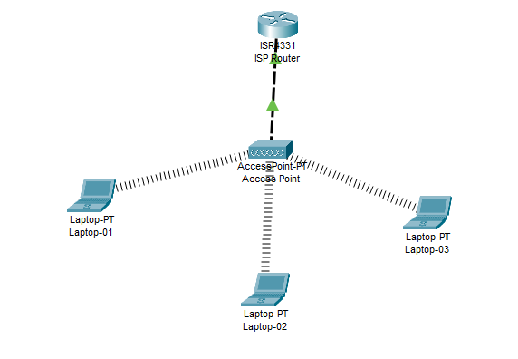
Wireless Network
To ensure reliable and efficient communication, wireless network administration includes the management, maintenance, and optimization of wireless networks. It includes an extensive range of responsibilities and duties, such as designing network security, monitoring network performance, implementing wireless access points (APs), and resolving connectivity problems.

Slide 24
Group Discussion
What are the network devices and how to configure.
What is VLANs what the use of Trunking.
What is Virtual Private Networks (VPNs)
What the use of Wireless Network.

